Slide 1
Wandsworth JSNA infographics

Slide 2
Contents:
People Infographics……................................................................3
Start Well Infographics……………………………………………………………10
Cardiovascular Disease Infographics……………………………………….18
Age Well Infographics………………………………………………………..……25
Obesity Infographics……………..…………………………………………….….33

Slide 3
People Infographics

Slide 4
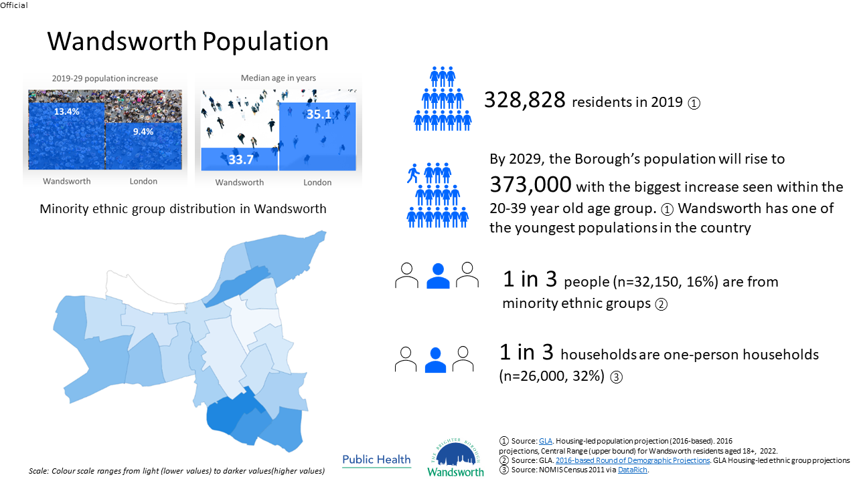

Slide 5


Slide 6
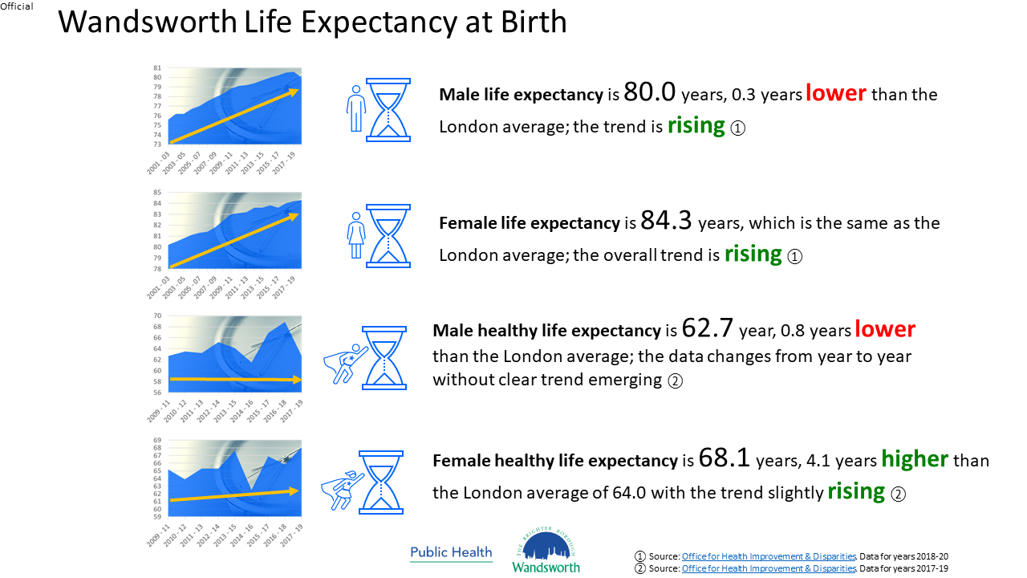

Slide 7
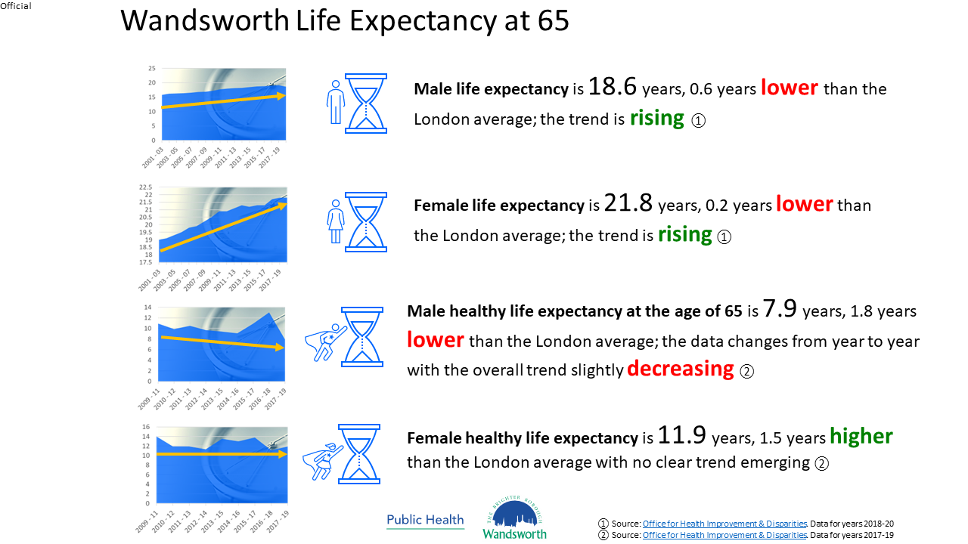

Slide 8
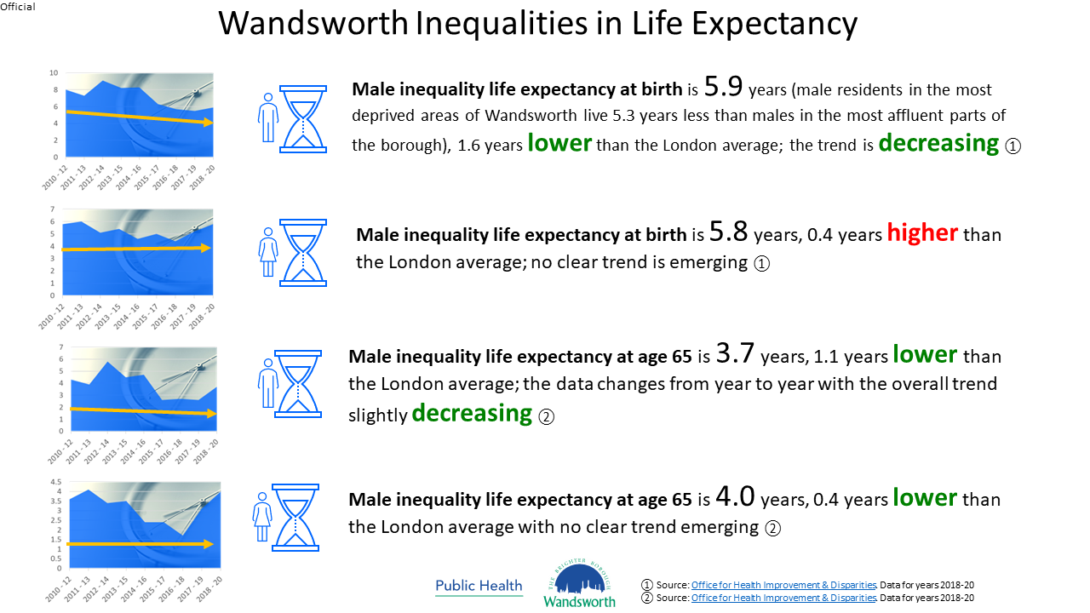

Slide 9
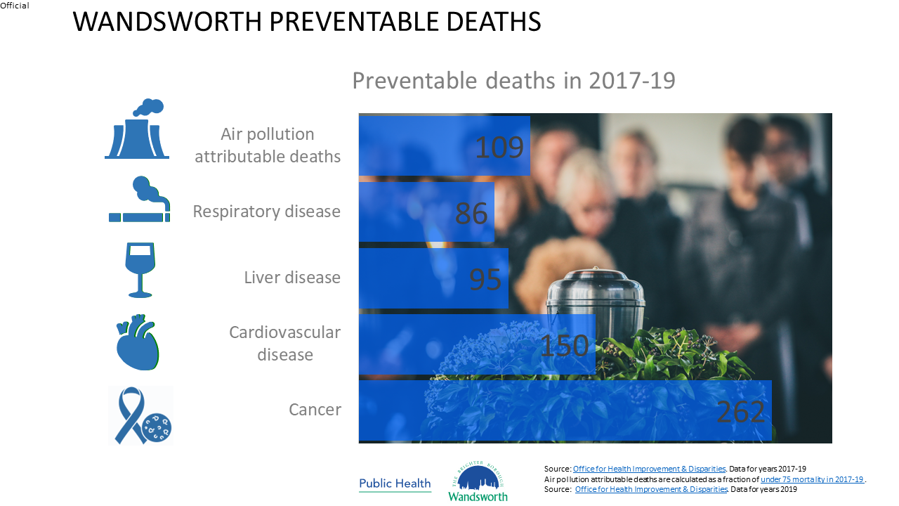

Slide 10
Start Well Infographics

Slide 11
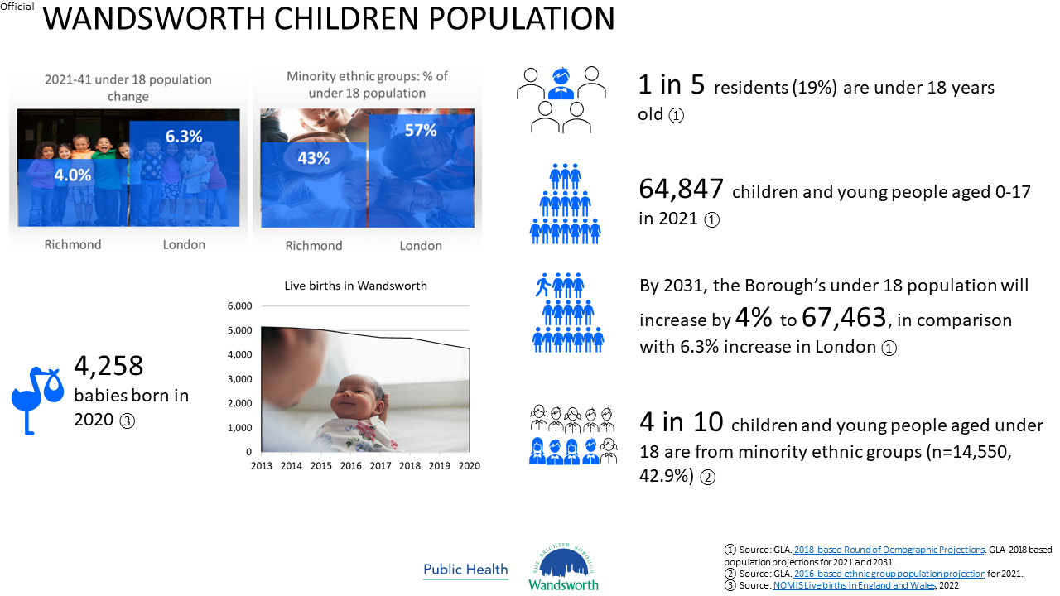

Slide 12
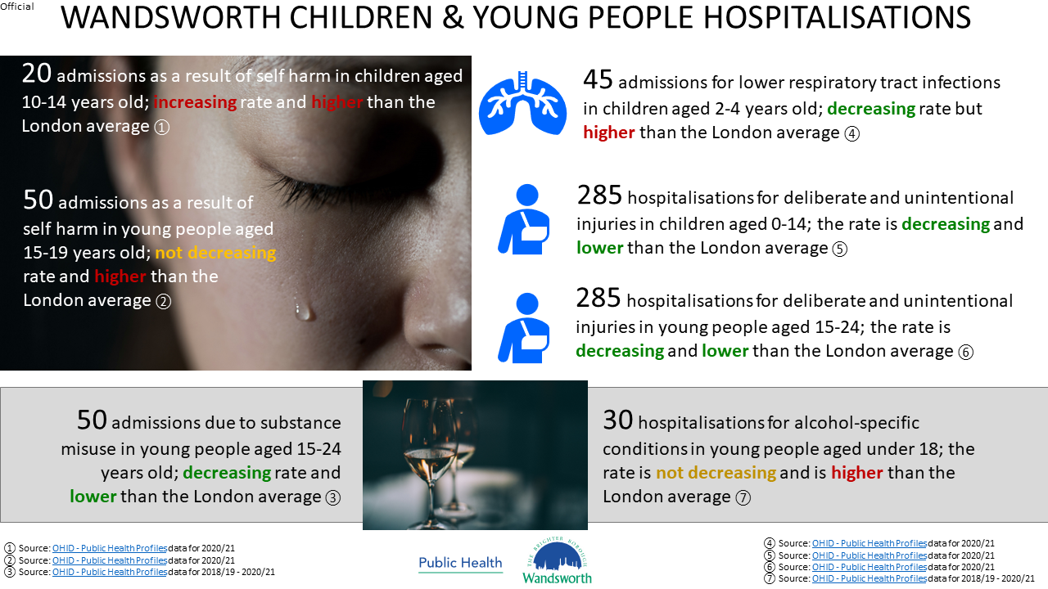

Slide 13


Slide 14
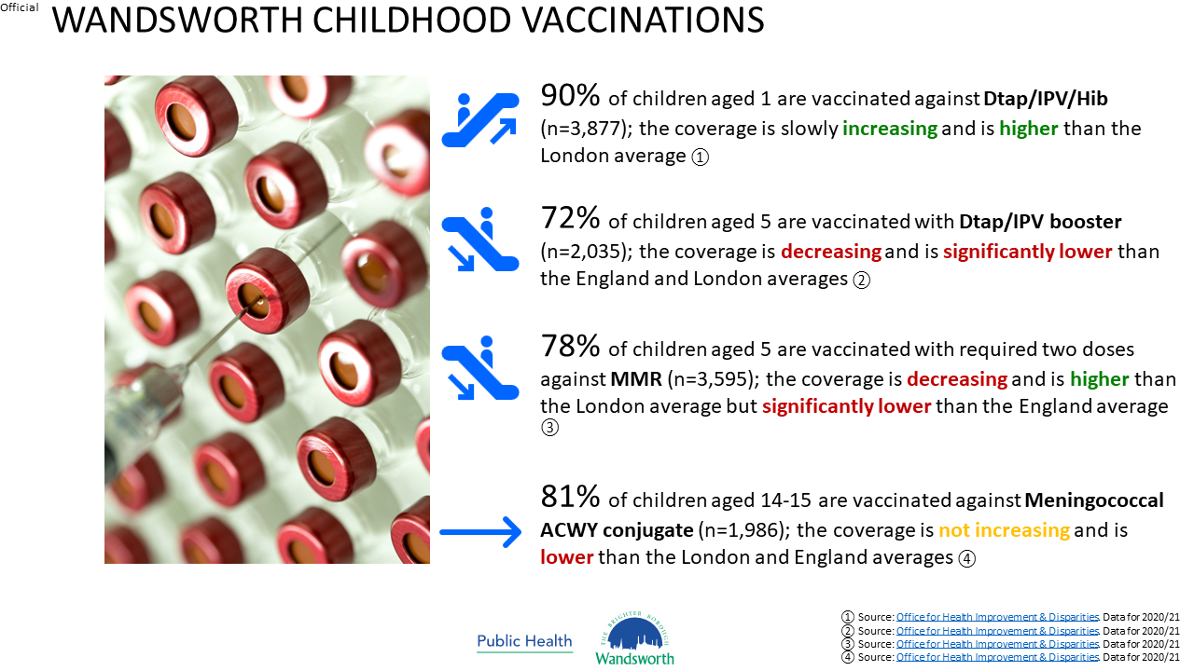

Slide 15
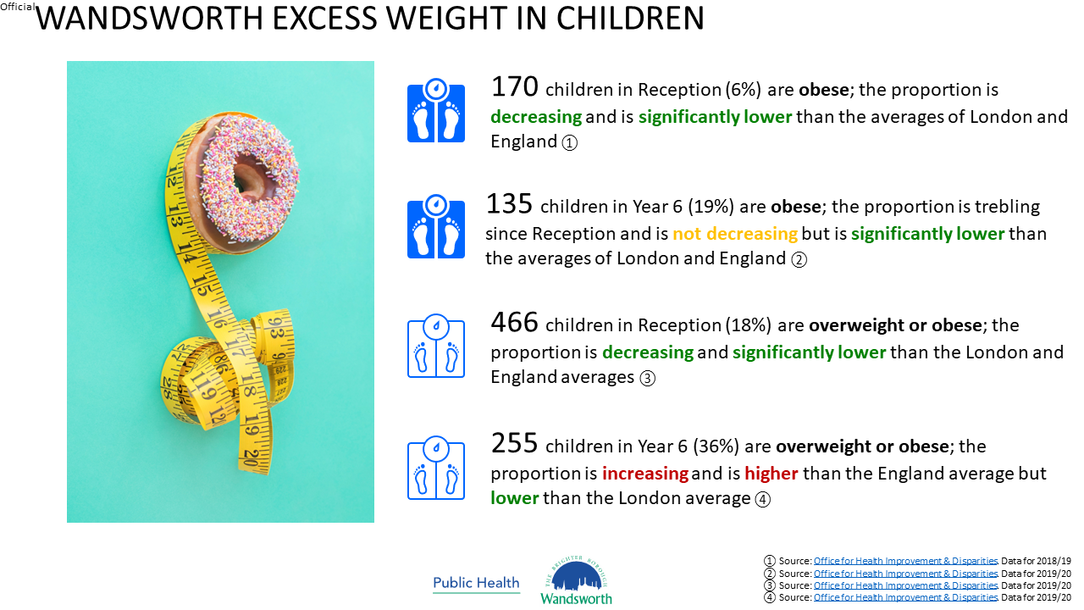

Slide 16
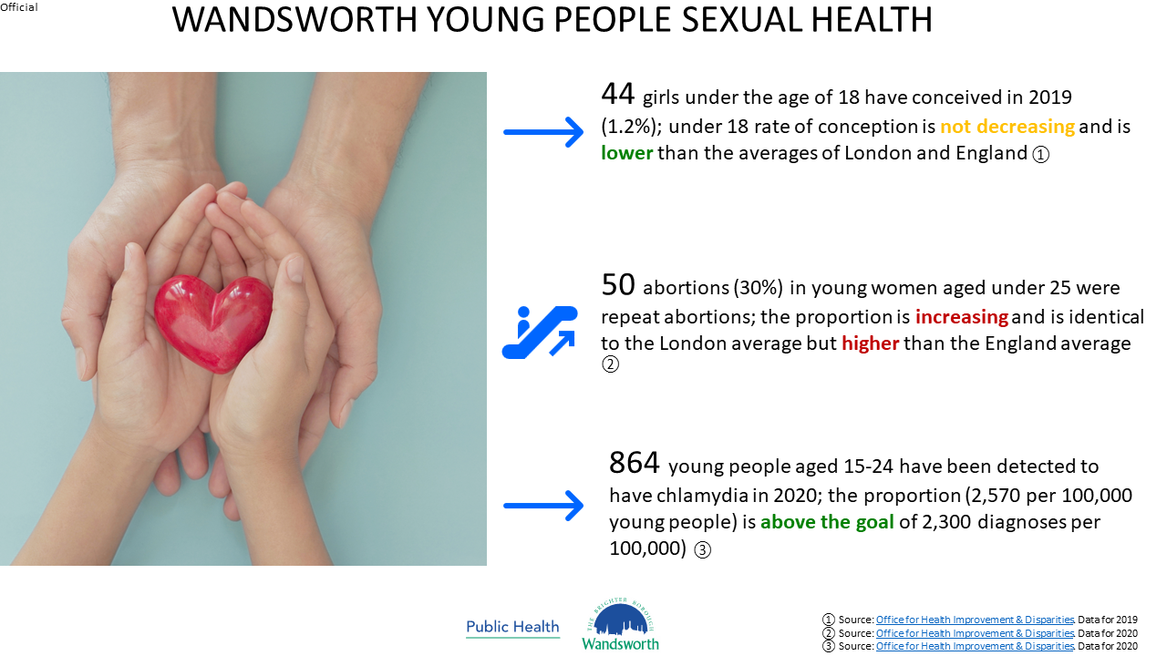

Slide 17


Slide 18
Cardiovascular Disease Infographics

Slide 19
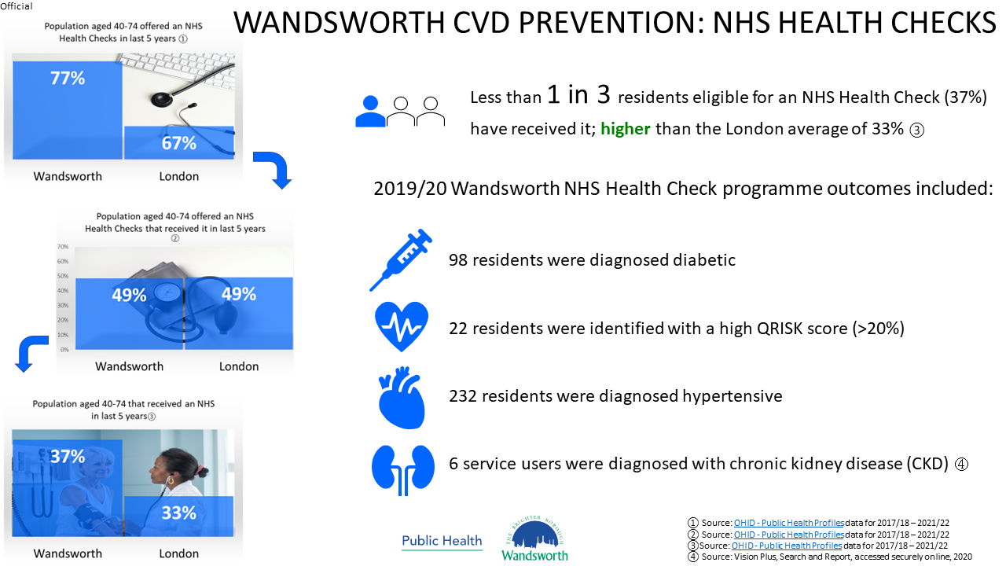

Slide 20
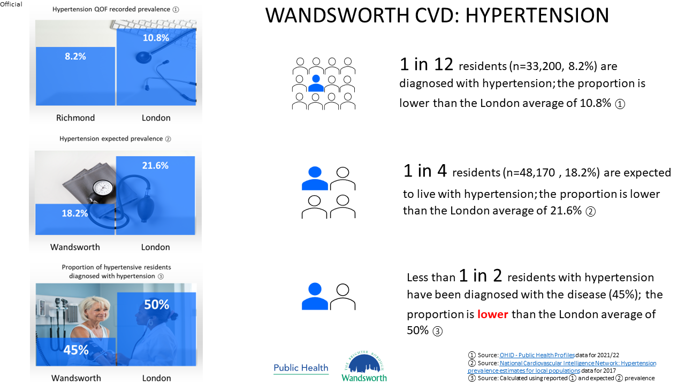

Slide 21
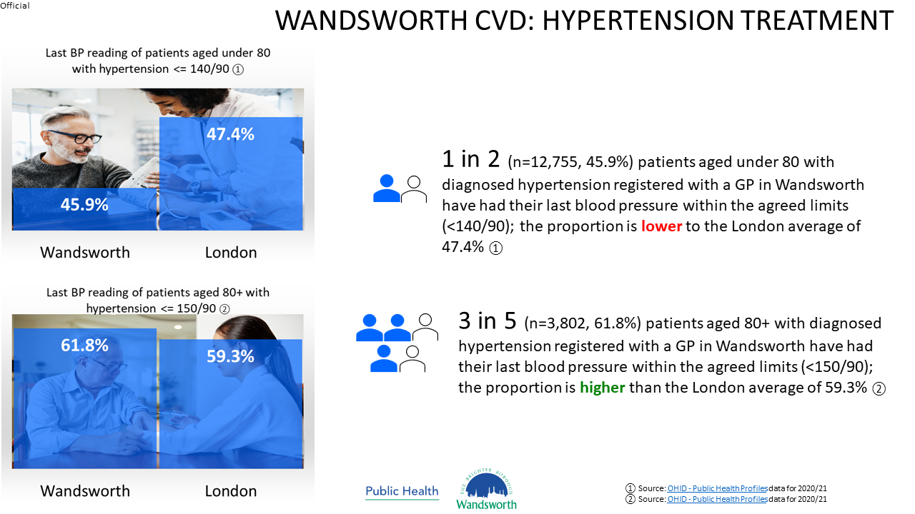

Slide 22
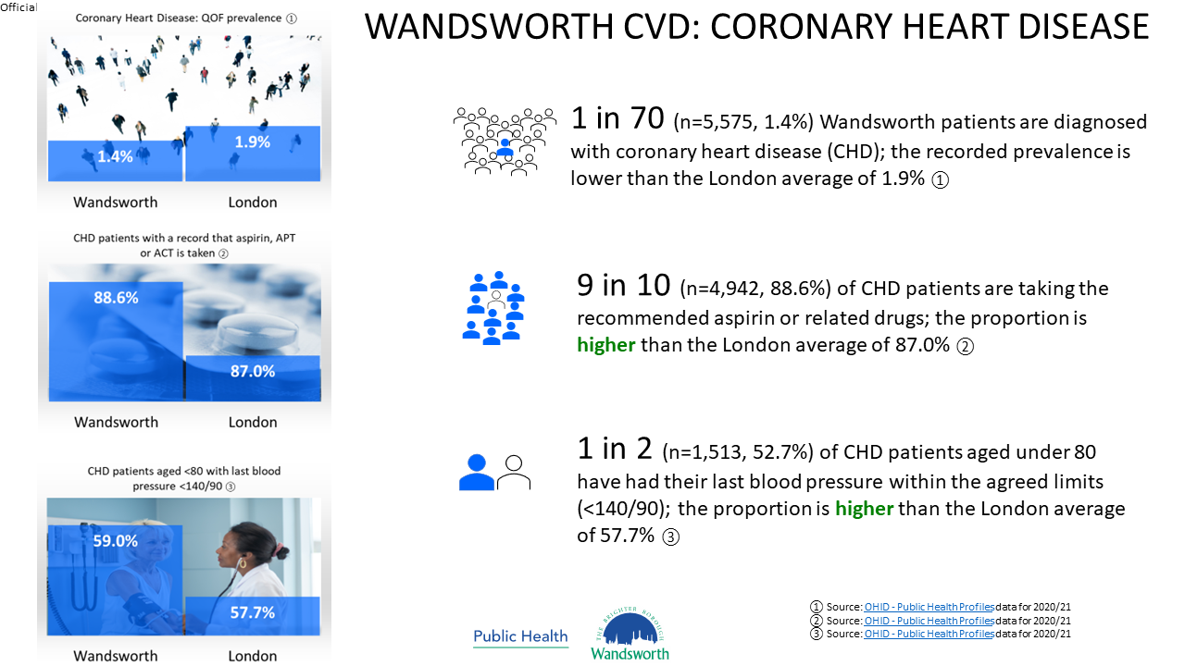

Slide 23
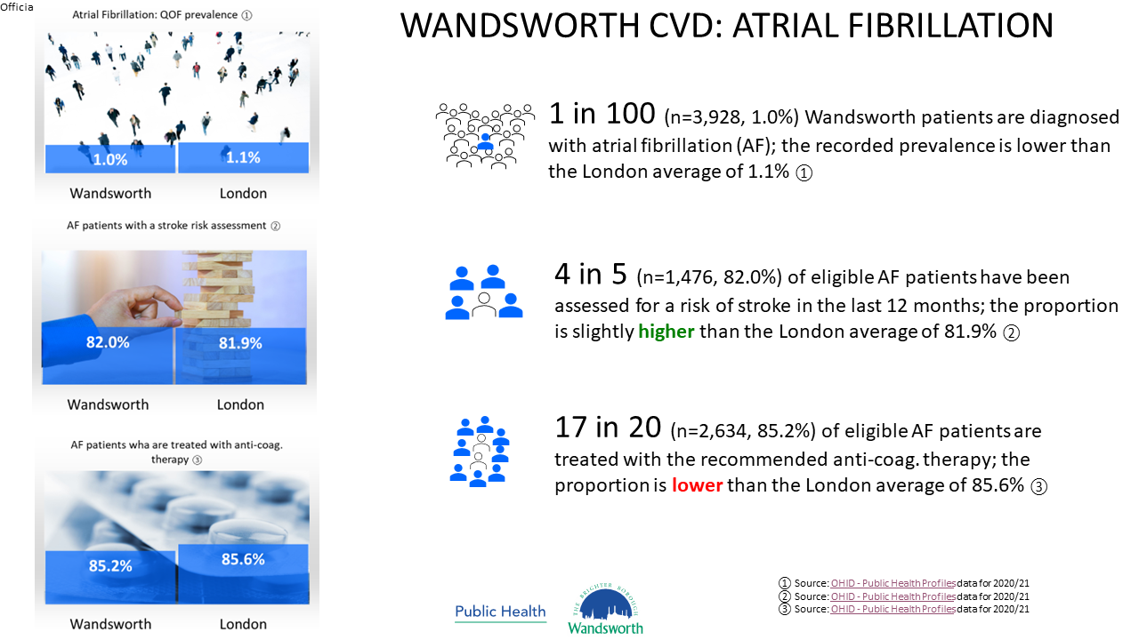

Slide 24
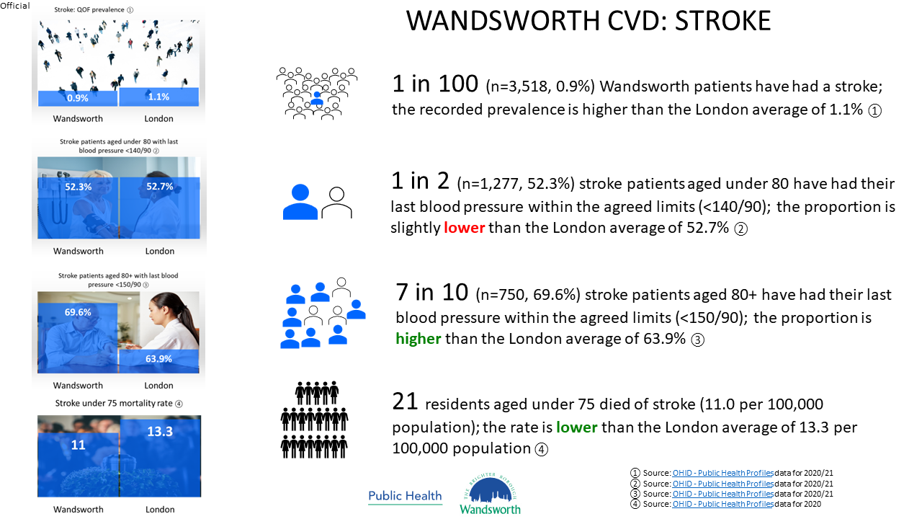

Slide 25
Age Well Infographics

Slide 26
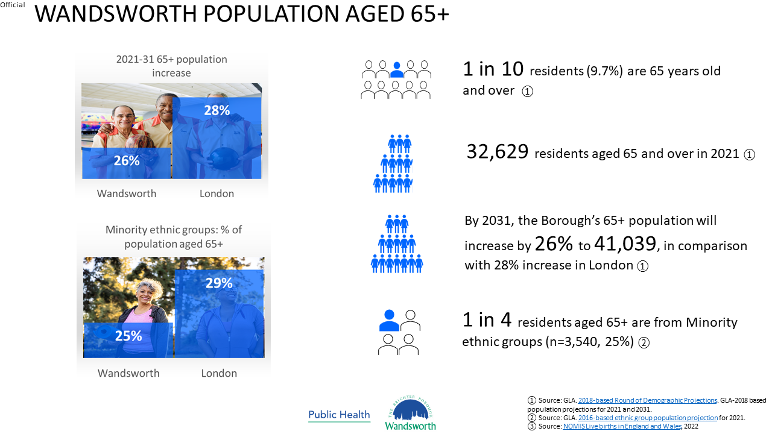

Slide 27
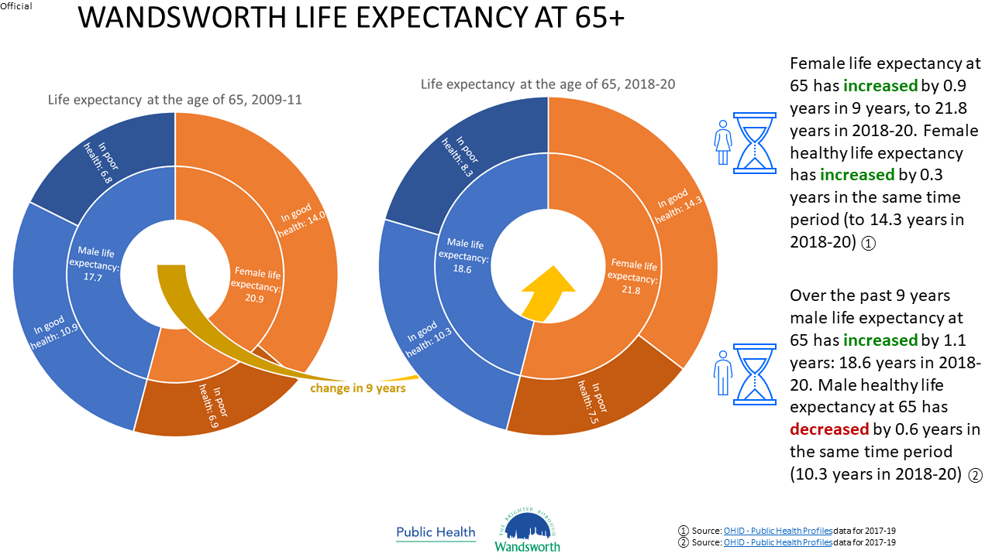

Slide 28
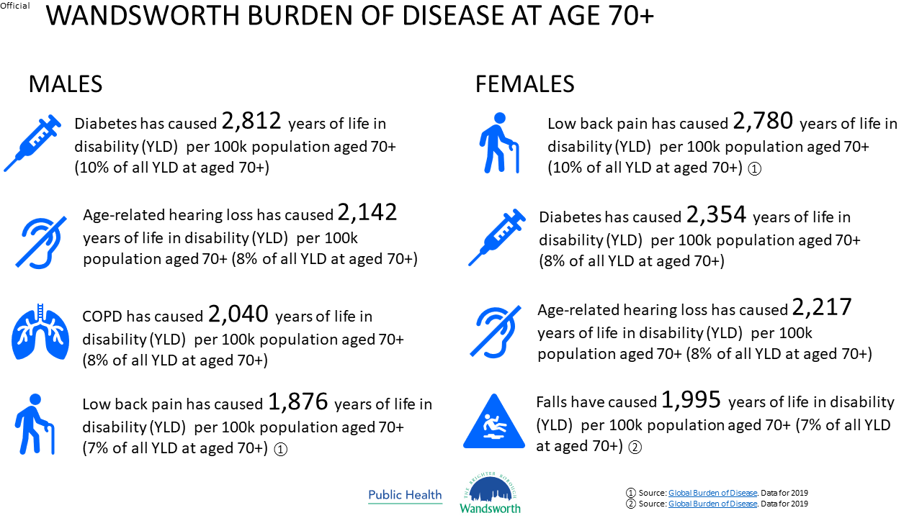

Slide 29
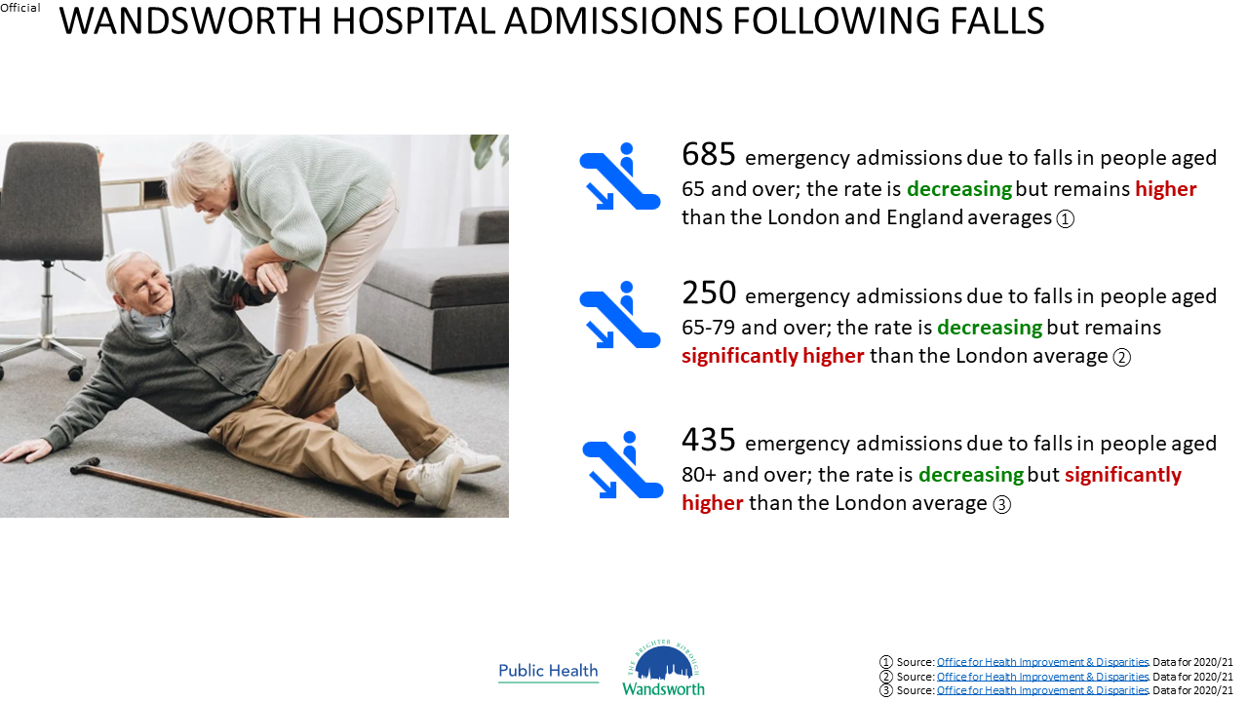

Slide 30
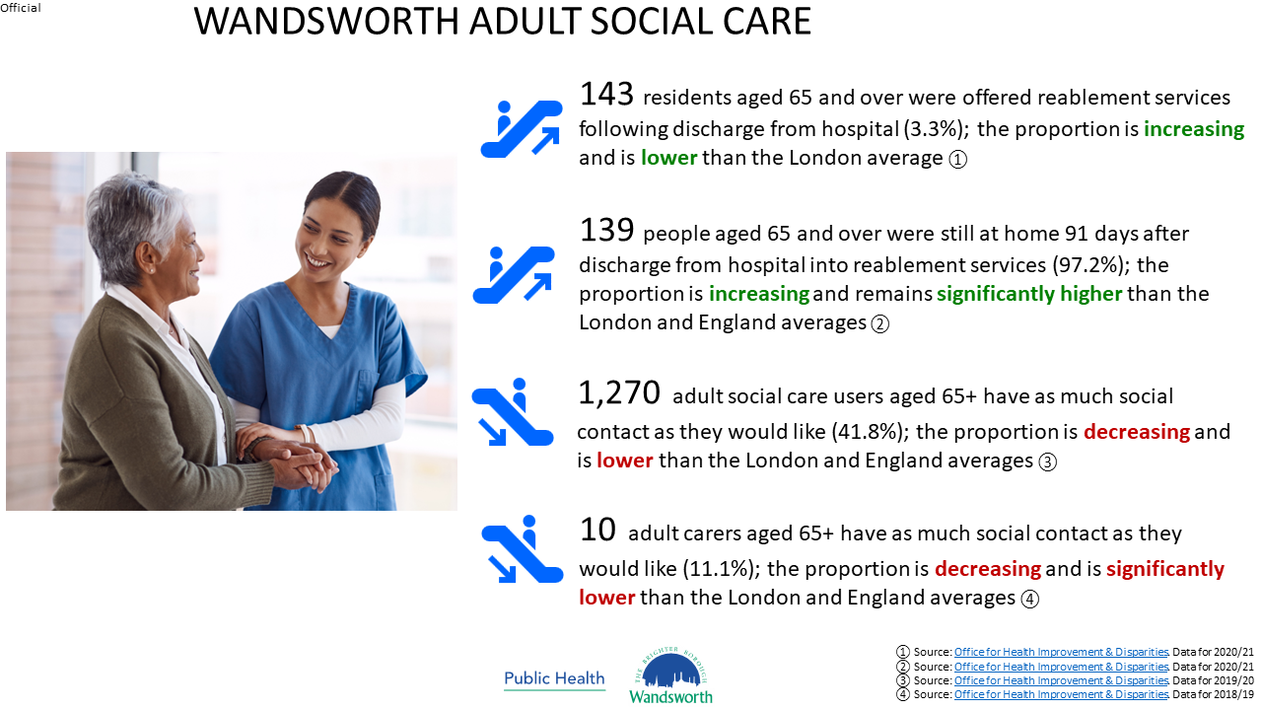

Slide 31
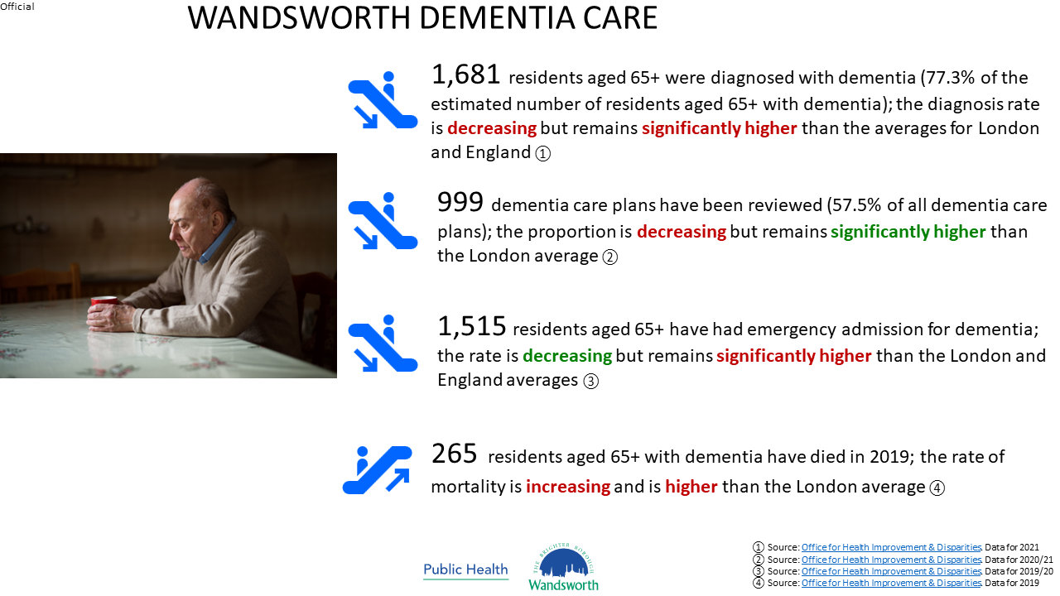

Slide 32
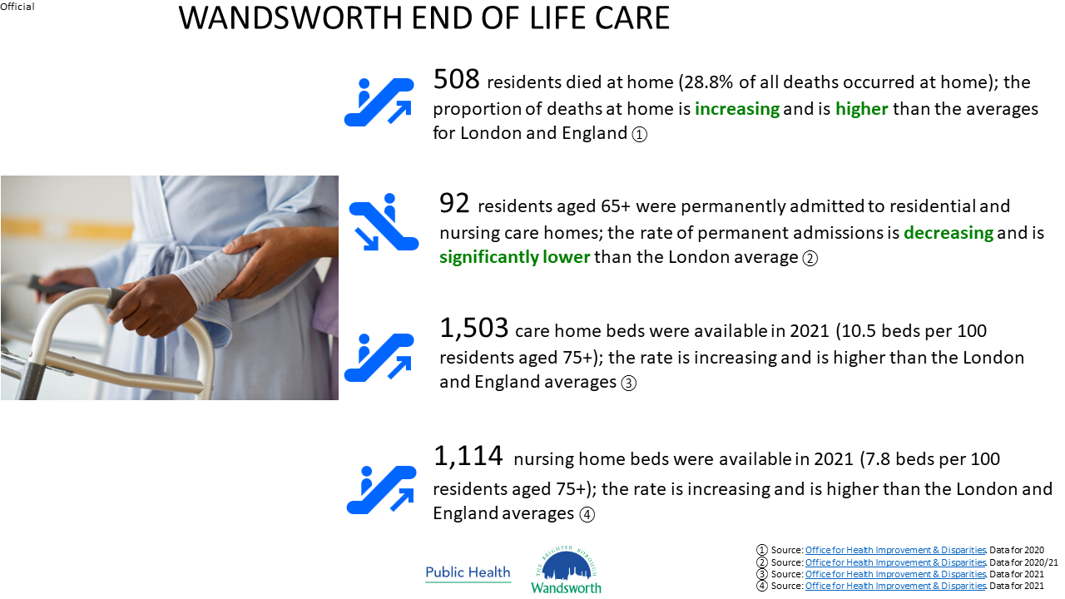

Slide 33
Obesity Infographics

Slide 34


Slide 35
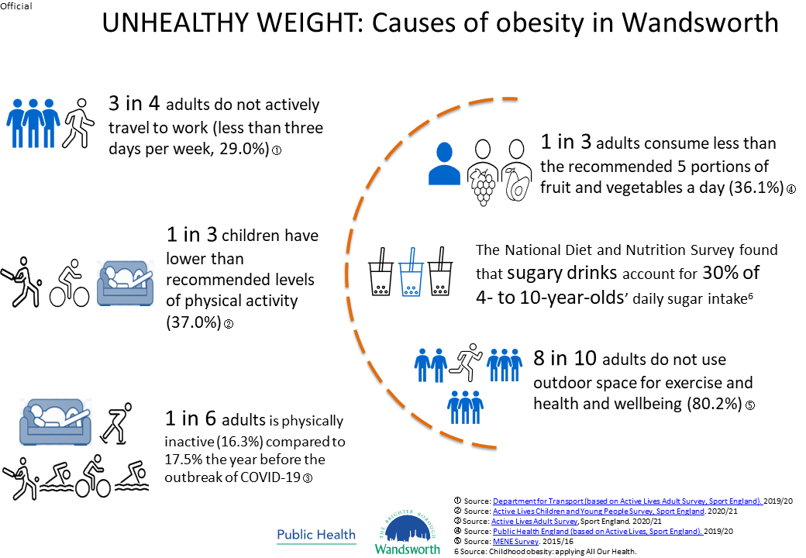

Slide 36


Slide 37
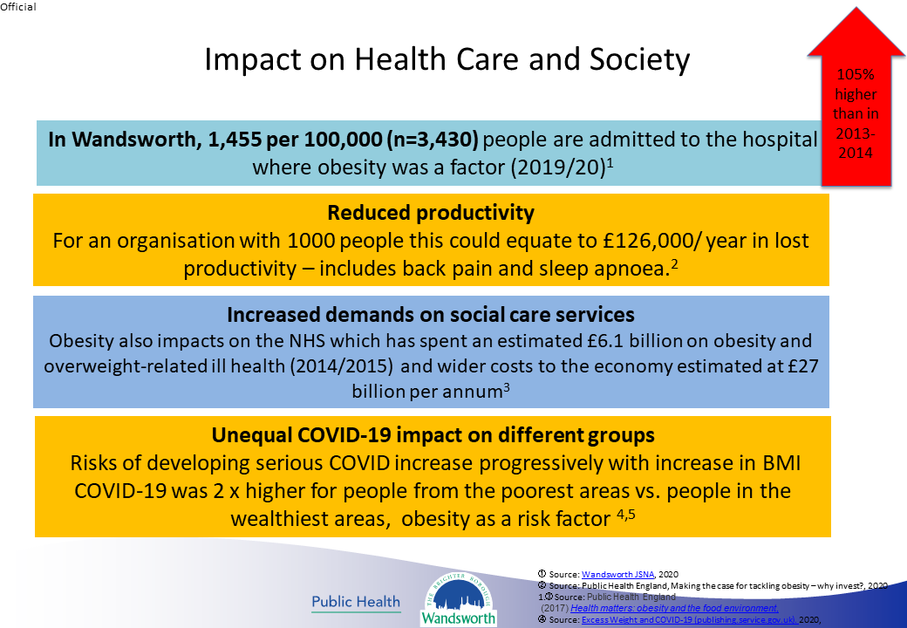

Slide 38


